Slide 1
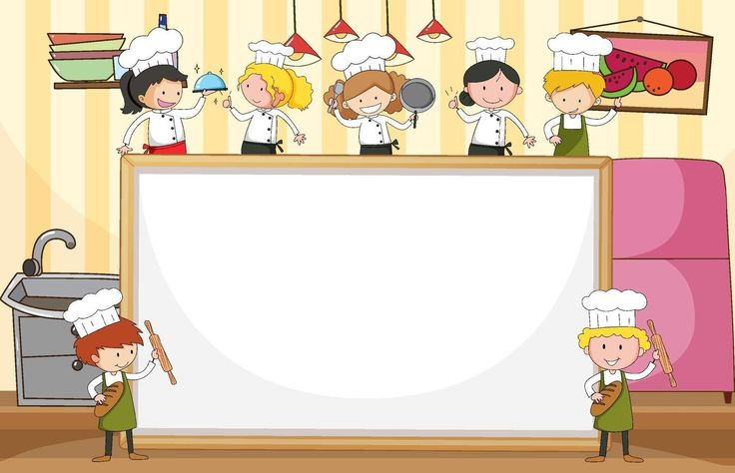
Restaurant Management System
NOOR-US-SABA
WARDA NOOR
SAFA WASEEM
AABRU MUMTAZ

Slide 2
Project Overview
This project implements a basic Restaurant Management System using C++.
Key features:
Display menu
Display staff
Display table,choose table,release table
Take order
Collect feedback

Slide 3
Introduction and Constants
1. Program Purpose:
Manage a restaurant system.
Handles staff, inventory, tables, menu, orders, and feedback.
2. Constants Used:
MAX_TABLES = 10MAX_STAFF = 5MAX_ITEMS = 5
3. Data Arrays:
Staff Names: {"Alice", "Bob", "Charlie", "Daisy",
"Eve"}
Inventory Items: {"Burger", "Pizza", "Pasta", "Salad", "Drinks"}
Stock Levels: {10, 8, 12, 15, 20}
Prices: {5.99, 8.99, 7.49, 4.99, 2.99}
Table Status: {0, 0, ...} (0 = Available, 1 = Occupied)

Slide 4
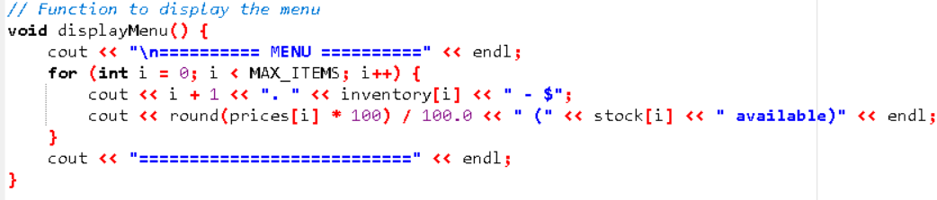
Display Menu
1. Menu Display:
Function: displayMenu()Displays all available items, prices, and stock levels.
Example Output:
========= MENU =========
1.Burger - $5.99 (10 available)
2. Pizza - $8.99 (8 available)
========================

Slide 5
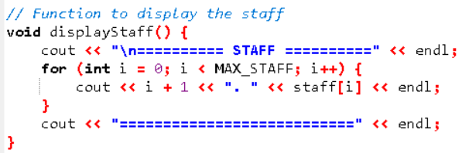
Display Staff
1.Staff Display:
Function: displayStaff()Prints all staff names in the system.
Example Output:
========= STAFF =========
1.Alice
2. Bob
3. Charlie
4. Daisy
5. Eve
=========================

Slide 6
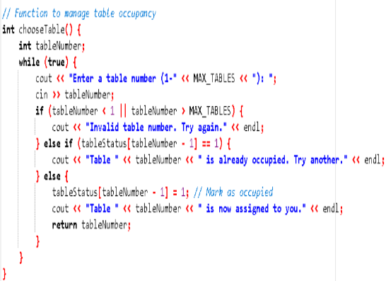
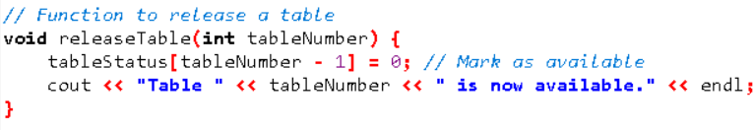
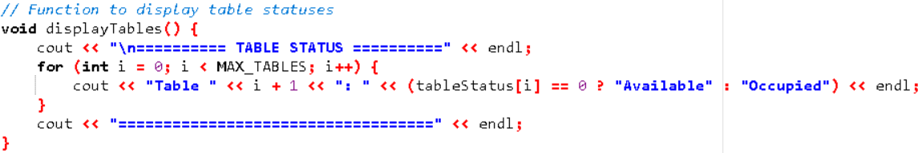
Display Table, Choose Table & Release Table
1.DisplayTables():
Functions: Displays table status (Available/Occupied).
2.ChooseTable():
Functions:
Prompts the customer to select a table.
Marks the table as occupied.
Validates input.
2.ReleaseTable(tableNumber):
Functions: Marks a table as available after use.

Slide 7
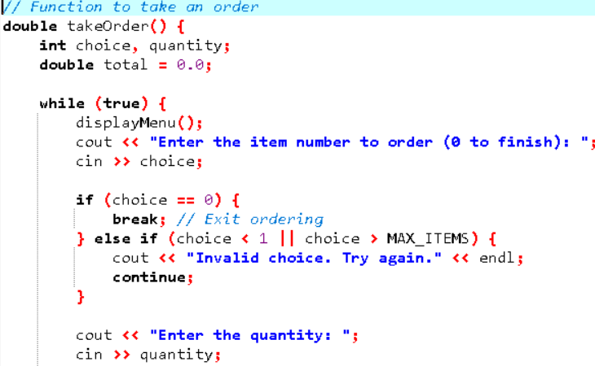
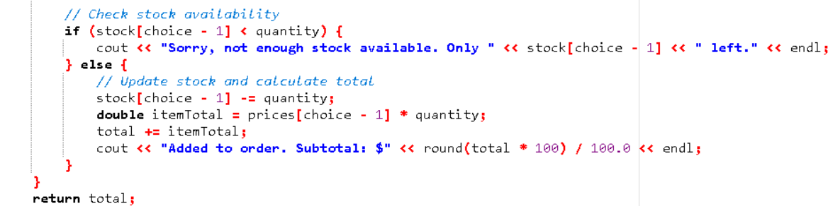
Take Order
Take Order :
Function: takeOrder()
Allows the customer to order items.
Checks stock availability.
Updates stock and calculates total bill.
Example Interaction:
Enter item number: 2
Enter quantity: 3
Subtotal: $26.97

Slide 8
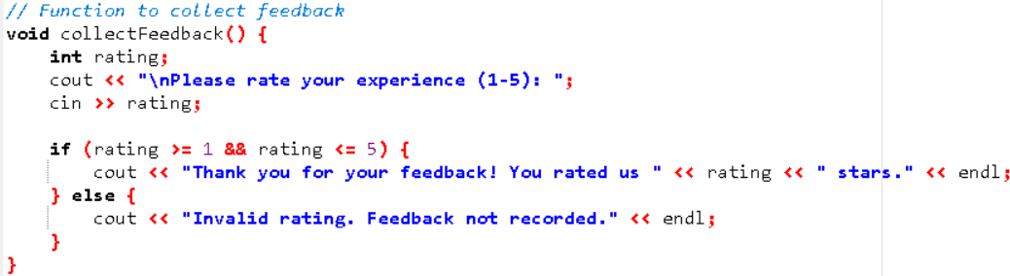
Collect Feedback ,Billing & Workflow
1.Feedback Collection:
Function: collectFeedback()Prompts the customer to rate their experience (1-5 stars).
Example Interaction:
Please rate your experience (1-5): 4
Thank you for your feedback!
2. Final Bill Display:
3. Program Workflow:
Display staff.
Show table statuses.
Assign a table.
Place an order.
Display the final bill.
Collect feedback.
Release the table.

Slide 9
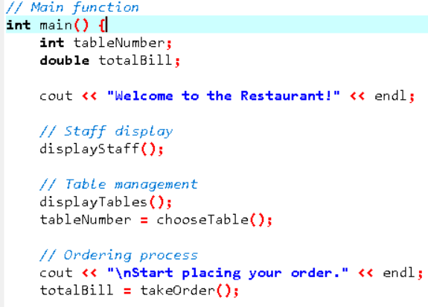
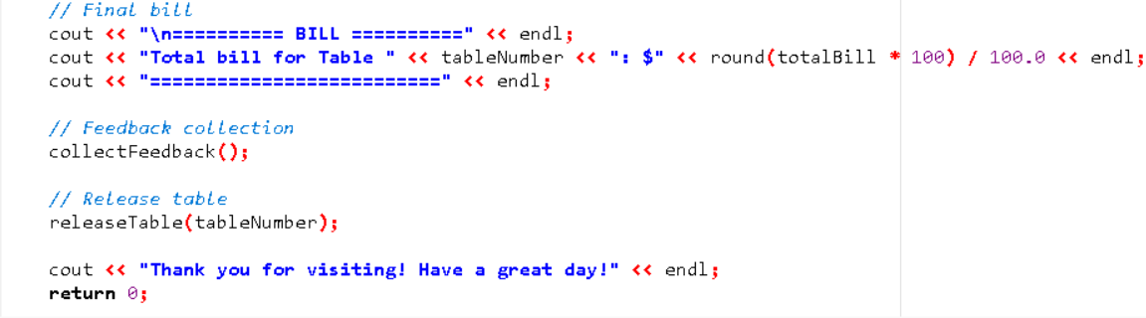
Main Function
.
The 'main' function provides a menu-driven interface to interact with the system.
Staff display: show available staff.
Table management: displays and selects tables.
Ordering process: take order and calculate bill.

Slide 10
THANK YOU

